Slide 1
WORKING WITH FUNCTIONS
Notes:
1

Slide 2
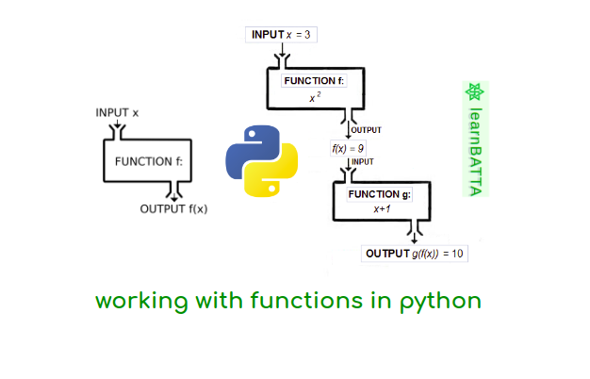

Slide 3
What is Function?
A function is a group of statements that is executed when it is called from some point of the program.
It’s a divide and conquer approach

Slide 4
TYPES OF FUNCTIONS

Slide 5
TYPES OF FUNCTIONS
Functions can be categorized into three types:-
1) Built in Functions.
2) Modules.
3) User - defined functions.

Slide 6
TYPES OF FUNCTIONS
1) BUILT IN FUNCTIONS
These are predefined function in python and are used as and when there is need by simply calling them. For example:
int()
float()
str()
min()
max() ...etc

Slide 7

TYPES OF FUNCTIONS
2) MODULES
Module is a container of functions, variables, constants, class in a separate file which can be reused.

Slide 8
IMPORTING MODULES
i) Import statement
ii) from statement

Slide 9
IMPORTING MODULES – import STATEMENT
i) import statement : used to import entire module.
Syntax: import modulename
example: import math

Slide 10
IMPORTING MODULES – import STATEMENT
ii) from: import all functions or selected one.
Syntax:
from module name import function name
for example:
from random import randint

Slide 11


3) USER DEFINED FUNCIONS
Function is a set of statements that performs specific task.
Syntax of user defined function
def function_name(list of parameters)
................
................
Statements
def is keyword

Slide 12
3) USER DEFINED FUNCIONS
def sum_diff(x,y):
add=x+y
diff=x-y
return add,diff
def main():
x=9
y=3
a,b=sum_diff(x,y)
print("Sum = ",a)
print("diff = ",b)
main()

Slide 13



PARAMETERS AND ARGUMENTS IN FUNCTION
Parameters are the values which are provided at the time of function definition.
def sum_diff(p,q):
add=p+q
diff=p-q
return add,diff
Parameters
Parameter is also called as formal parameter

Slide 14


PARAMETERS AND ARGUMENTS IN FUNCTION
Arguments are the values which are passed while calling a function
def main():
x=9
y=3
a,b=sum_diff(x,y)
print("Sum = ",a)
print("diff = ",b)
main()
Arguments
Argument is also called as actual parameter

Slide 15
TYPES OF ARGUMENTS
Python supports following type of arguments:
Positional arguments
Default Arguments
Keyword Arguments
Variable Length Arguments
Notes:
15

Slide 16
1. POSITIONAL ARGUMENTS
These are the arguments passed to a function in correct positional order
For example:
def substract(a,b):
print(a-b)
substract()
>>substract(100,200)
-100
>>substract(150,100)
50
Notes:
16

Slide 17
2. DEFAULT ARGUMENTS
When a function call is made without arguments, the function has defalut values for it for example:
For example:
def greet_msg(name=“Mohan”):
print(“Hello “, name)
greet_msg(“Vinay”) # valid
greet_msg() #valid
Notes:
17

Slide 18
2. DEFAULT ARGUMENTS
When a function call is made without arguments, the function has default values for it
for example:
For example:
def greet_msg(name=“Mohan”,msg=“GoodMorning”):
print(name,msg)
greet_msg()
def greet_msg(name=“Mohan”,msg): # invalid
print(name,msg)
greet_msg()
Notes:
18

Slide 19
3. KEYWORD ARGUMENTS
if function containing many arguments, and we wish to specify some among them, then value for such parameter can be provided by using the name
For example:
def greet_msg(name,msg):
print(name,msg)
#calling function
greet_msg(name=“Mohan”,msg=“Hi”): # valid
O/p -> Mohan Hi
Notes:
19

Slide 20
3. KEYWORD ARGUMENTS
For example:
#calling function
greet_msg(msg=“Hi”,name=“Mohan”): # valid
O/p -> Mohan Hi
Notes:
20

Slide 21
4. VARIABLE LENGTH ARGUMENTS
In some situation one needs to pass as many as argument to a function, python provides a way to pass number of argument to a function, such type of arguments are called variable length arguments.
Variable length arguments are defined with * symbol.
For Example: (next slide)
Notes:
21

Slide 22
4. VARIABLE LENGTH ARGUMENTS
For Example:
def sum(*n):
total=0
for i in n:
total+=i
print(“Sum = “, total)
sum()
# Calling function
sum() o/p sum=0
sum(10) o/p sum=10
sum(10,20,30,40) o/p sum=100
Notes:
22

Slide 23

PASSING ARRAYS/LISTS TO FUNCTIONS
Arrays in basic python are lists that contain mixed data types and can be passed as an argument to a function.
For Example: # Arithmetic mean of list
def list_avg(lst):
l=len(lst)
sum=0
for i in lst:
sum+=i
return sum/l
def main():
print(“Input integers”)
a=input()
a=a.split()
for i in range(len(a) ):
a[i]=int(a[i])
avg=list_ave(a)
print (“Average is = “, avg)
Notes:
23

Slide 24
SCOPE OF VARIABLES
Scope mean measure of access of variable or constants in a program. Generally there are two types of scope of variables:
i) Global (Module)
ii) Local (Function)
Global variables are accessed throughout the program their scope is global
Local variables are accessed within the program and their scope is local only.
Notes:
24

Slide 25
GLOBAL VARIABLES & LOCAL VARIABLES
For Example:
GLOBAL VARIABLE
def main():
x=9
y=3
a,b=add_diff(x,y)
print("Sum = ",a)
print("diff = ",b)
print("m in main function = ",m)
main()
LOCAL VARIABLES
m=100
def add_diff(x,y):
add=x+y
diff=x-y
global m
m= m +10
print("m in add_diff function=",m)
return add,diff
Notes:
25

Slide 26
Let’s practice
Write a Python function that takes a string as input and converts each uppercase letter to lowercase, each lowercase letter to uppercase, and replaces all non-alphabetic characters with ‘bb’
WAF to print the elements of a list in a single line. ( list is the parameter)
WAF to find the factorial of n. (n is the parameter)
WAF to print the length of a list. ( list is the parameter)
Write a function that greets the user by name.
Create a function that takes three numbers and returns the largest one.
Build a menu-based calculator using separate functions for add, subtract, multiply, and divide. (Assignment)

